Slide 1
Diversification & SSE models

Slide 2
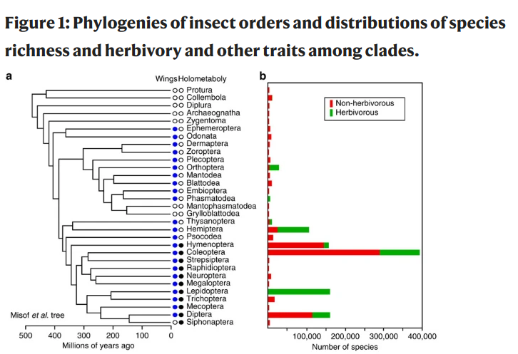
Trait-dependent diversification
One approach: Estimate net div in a bunch of clades, estimate trait (prop/freq) in same clades, see if correlated (w/PGLS)

Slide 3
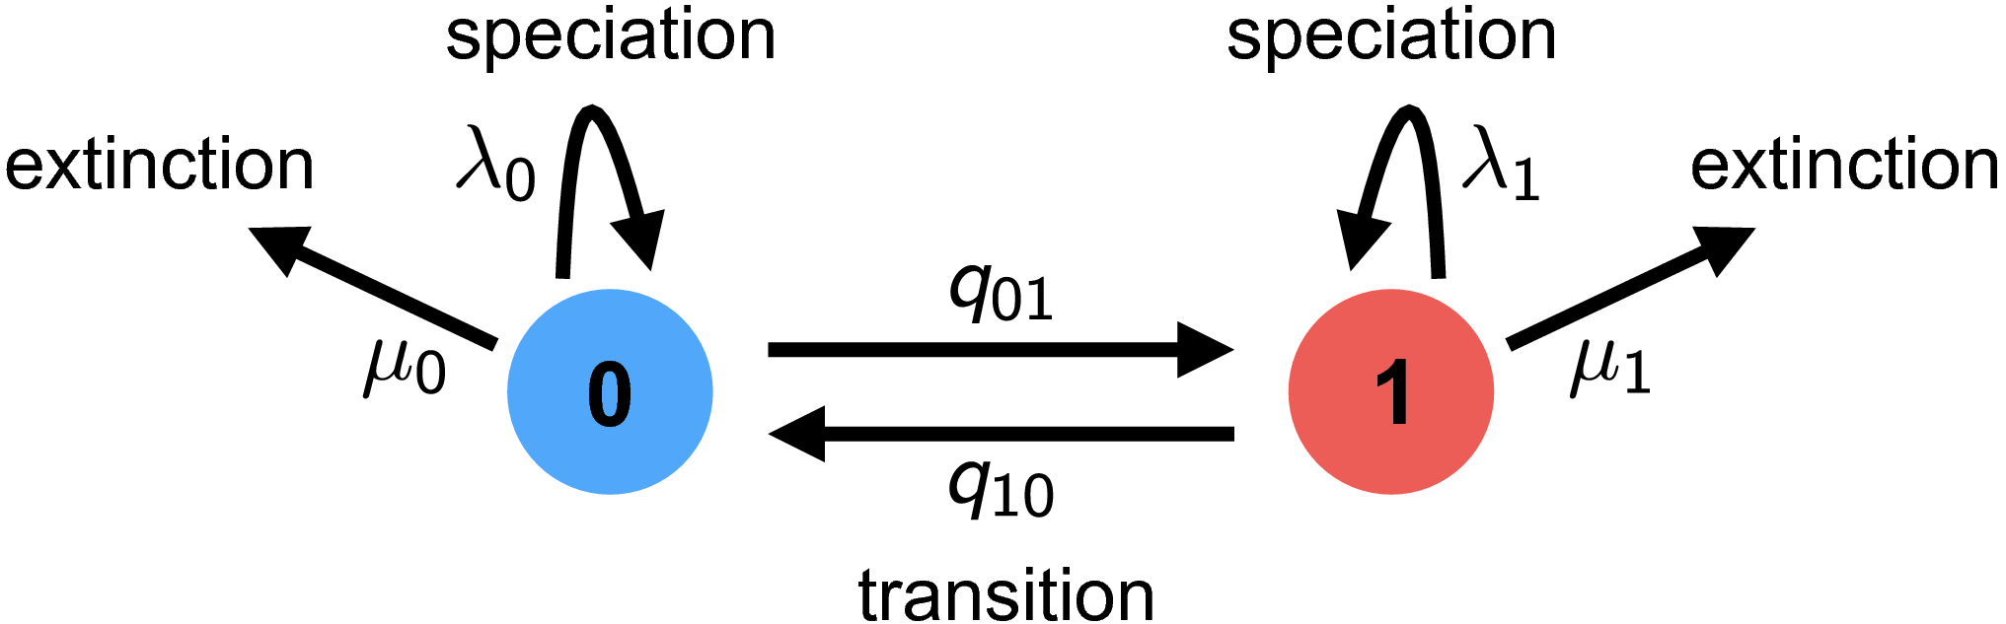
Trait-dependent Diversification
Species Selection (sometimes species sorting)
-- Controversial?!? Not anymore!

Slide 4
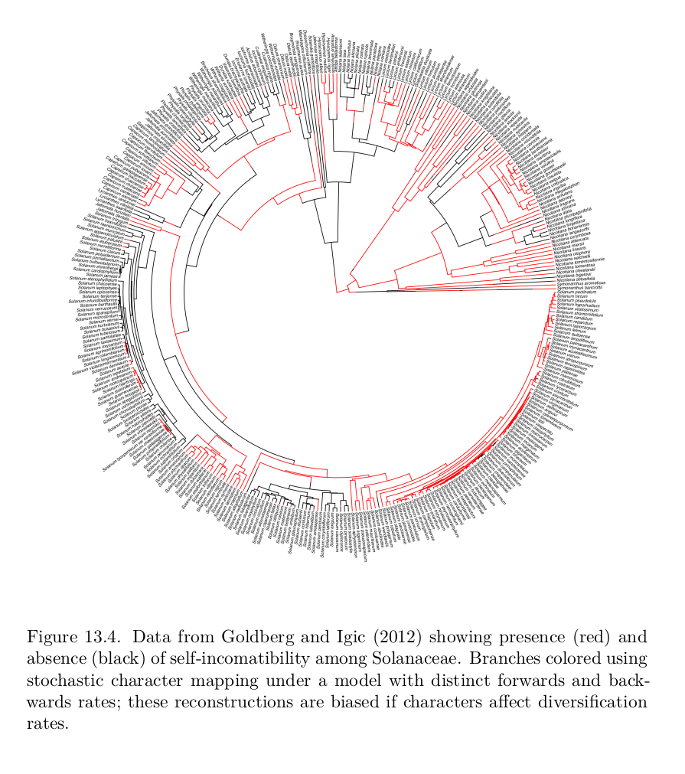
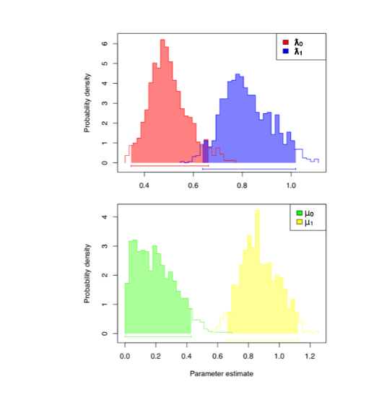
Why important?
Ancestral state reconstructions biased with trait-dependent diversification! (Maddison 2007)

Slide 5

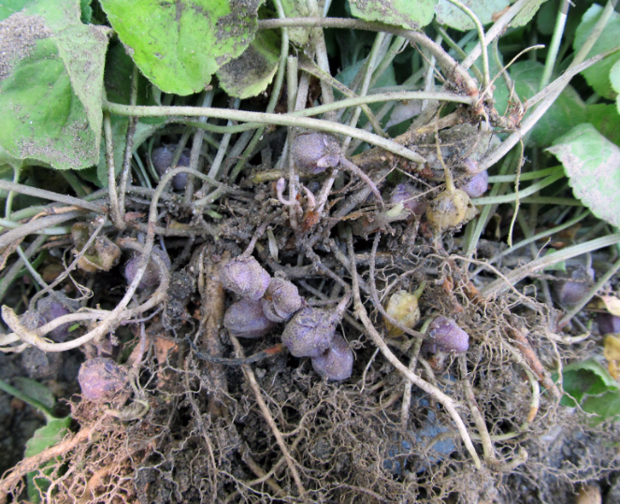
Which is better? How will it affect speciation/extinction?
Self-incompatibility
(Obligate outcrossing)
Self-compatibility
(Selfing possible)

Slide 6
Example:
Self-incompatibility in plants: Prevents selfing
Equal distribution but...
Selfing results in higher speciation rates AND higher extinction rates
Ancestor more likely SI than SC

Slide 7
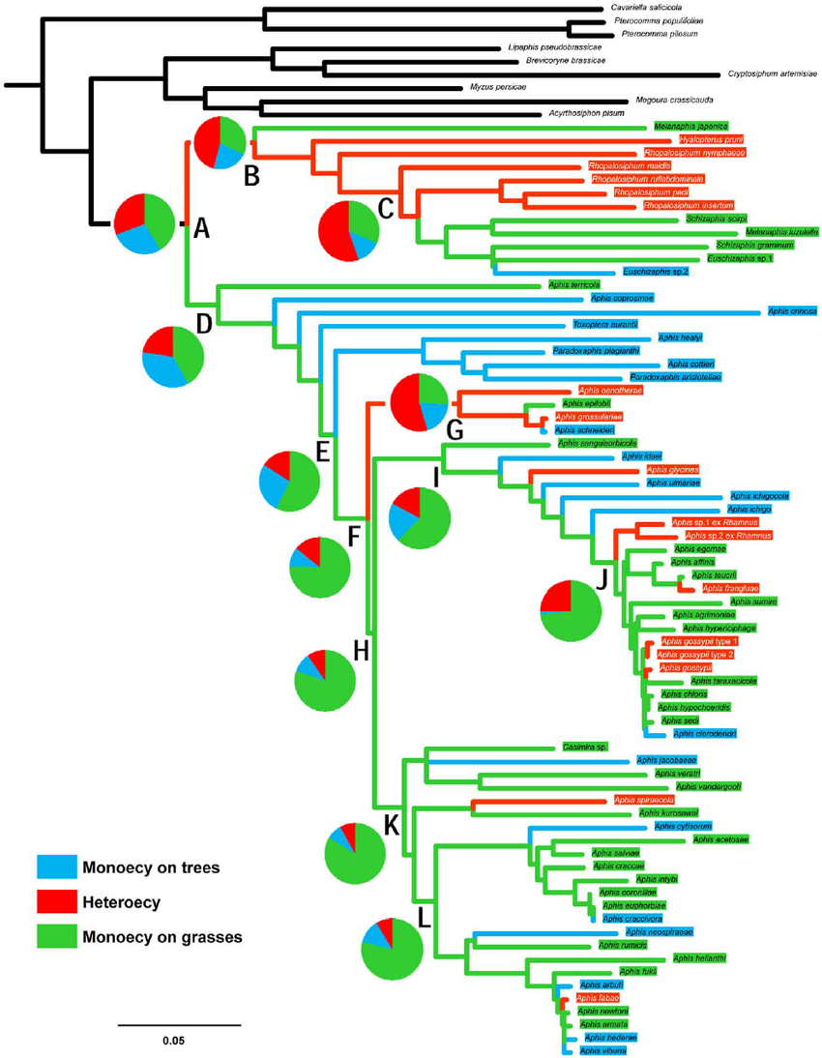
A word about Ancestral State Reconstruction...
Whether under BM/OU/CTMC etc.
ML: Assumes ML param. are known without error, uncertainty is assuming you know the true model without error
Since we are always uncertain about the model, we should always assume more uncertainty
Can be even worse: BM vs. BM with a trend
CI for ancestral state under BM vs.
BM w/trend?
Darwinian uncertainty principle

Slide 8
The SSE family of models
Trait models:
BiSSE: Binary State-dependent Speciation and Extinction (extensions for incompletely resolved trees)
MuSSE: Multiple SSE
QuaSSE: Quantitative SSE (but slow)
Models where something special happens at nodes:
GeoSSE: Geographic SSE (DEC + SSE)
BiSSE-ness/ClaSSE: Cladogenetic SSE
Hidden-state models that account for background heterogeneity:
HiSSE: Hidden-State SSE (Solution to problem pointed out by Rabosky and Goldberg)
GeoHiSSE: Geographic Hidden-State SSE

Slide 9
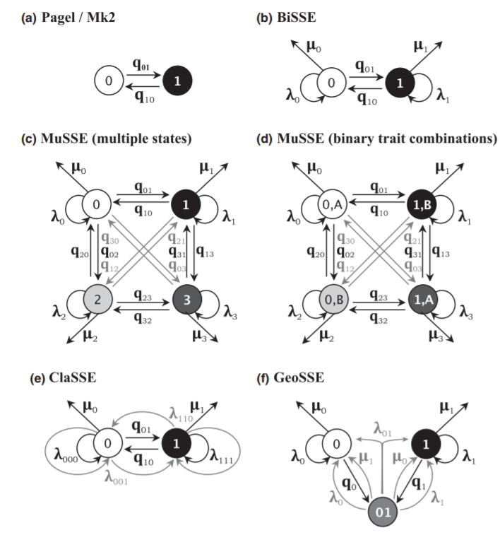
Ng & Smith 2014, Journal of Evolutionary Biology

Slide 10
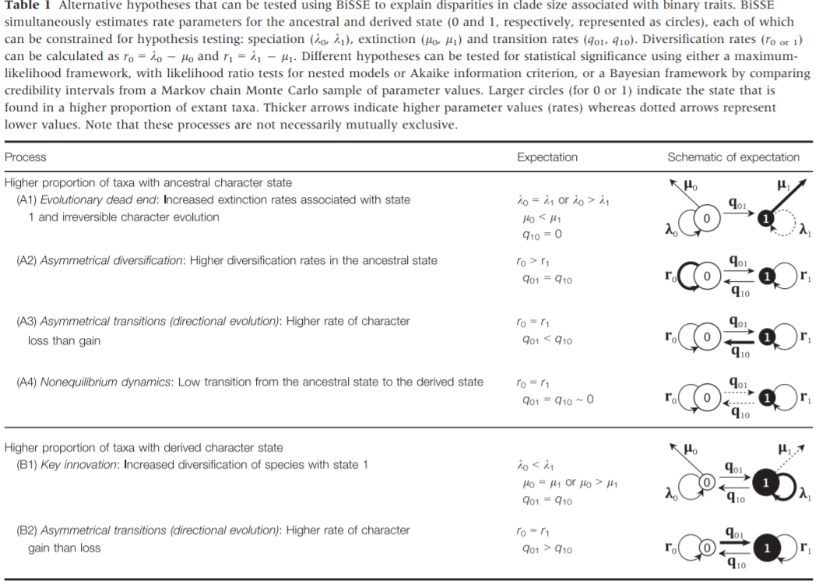
Ng & Smith 2014, Journal of Evolutionary Biology

Slide 11
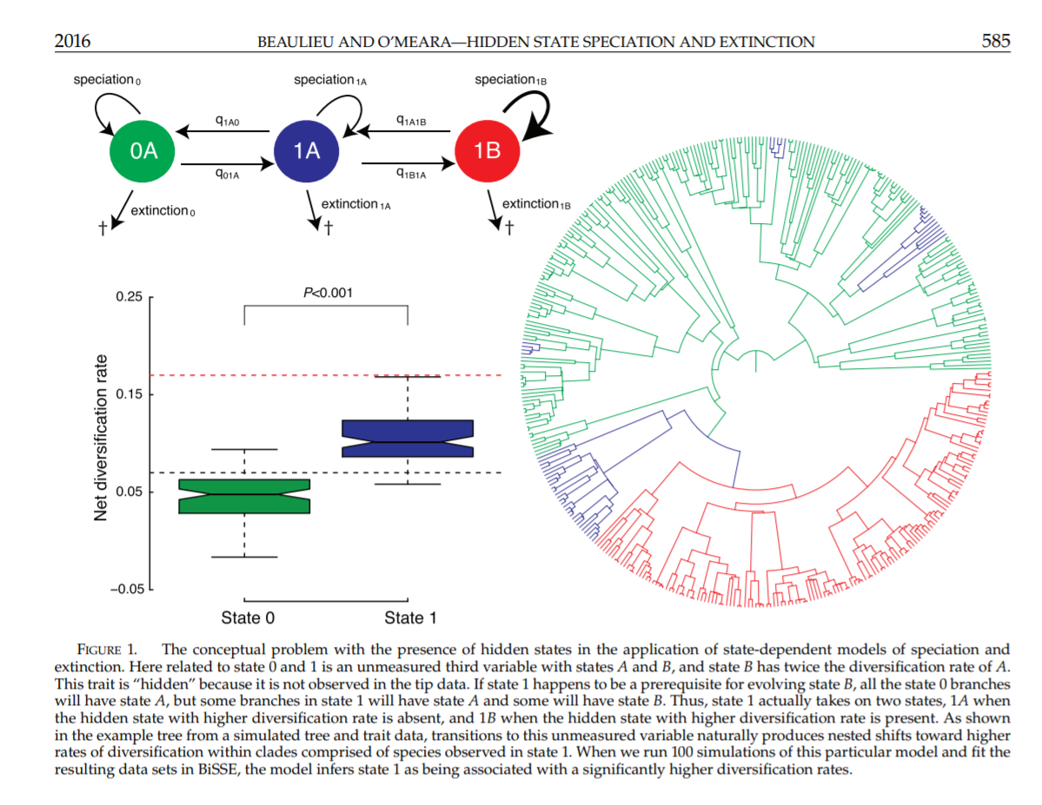

Slide 12

Diversitree lab

